Slide 1

Database NORMALIZATION

Slide 2



OBJECTIVES
State what is meant by database normalization
Normalize relations to 1st normal form
Normalize relation to 2nd normal form
Normalize relation to 3rd Normal Form

Slide 3

Review
In pairs provide the answers to the following
Describe the three types of data anomalies
Explain what is functional dependency
Explain what is transitive dependency

Slide 4


What is Database NORMALIZATION?
Normalization is the process of organizing data in a database.
This includes creating tables and establishing relationships between those tables eliminating redundancy and data anomalies.
The purpose of database normalization is to reduce data redundancy and limit inconsistences by use of
Entity Relationship Modelling (ERD)
Normalization Technique

Slide 5

Why Normalize a database
Make the database more efficient
Prevent the same data from being stored in more than one place (called an “insert anomaly”)
Prevent updates being made to some data but not others (called an “update anomaly”)
Prevent data not being deleted when it is supposed to be, or from data being lost when it is not supposed to be (called a “delete anomaly”)
Ensure the data is accurate
Reduce the storage space that a database takes up
Ensure the queries on a database run as fast as possible

Slide 6

First Normal Form
Rules of 1NF
A relation is in first normal form (1NF) if (and only if):
All rows must be unique (no duplicate rows)
Each cell must only contain a single value (not a list)
Each value should be non divisible (can't be split down further)

Slide 7
0 Normal Form (0NF) Another example
Problem 1 - All rows must be uniquely identifiable
Customer Name | Order
Bob Jones | Burger, Fries, Coke
Fred Jones | Nuggets, Lemonade, Fries
Bob Jones | Burger, Fries, Coke
Identical Rows
Customer Name | Order
Bob Jones | Burger, Fries, Coke
Fred Jones | Nuggets, Lemonade, Fries
Bob Jones | Burger, Fries, Coke

Slide 8
Add an order ID as a primary key
OrderID | Customer Name | Order
1 | Bob Jones | Burger, Fries, Coke
2 | Fred Jones | Nuggets, Lemonade, Fries
3 | Bob Jones | Burger, Fries, Coke
Problem 2 - Each cell must only contain a single value
OrderID | Customer Name | Order
1 | Bob Jones | Burger, Fries, Coke
2 | Fred Jones | Nuggets, Lemonade, Fries
3 | Bob Jones | Burger, Fries, Coke
Multiple Values!

Slide 9
Solution Create a separate table with order items
OrderID | Item
1 | Burger
1 | Fries
1 | Coke
2 | Nuggets
2 | Lemonade
2 | Fries
3 | Burger
3 | Fries
3 | Coke
OrderID | Customer Name
1 | Bob Jones
2 | Fred Jones
3 | Bob Jones

Slide 10
Problem 3 - All data must be atomic (non-divisible)
OrderID | Item
1 | Burger
1 | Fries
1 | Coke
2 | Nuggets
2 | Lemonade
2 | Fries
3 | Burger
3 | Fries
3 | Coke
OrderID | Customer Name
1 | Bob Jones
2 | Fred Jones
3 | Bob Jones

Slide 11
Solution
OrderID | Item
1 | Burger
1 | Fries
1 | Coke
2 | Nuggets
2 | Lemonade
2 | Fries
3 | Burger
3 | Fries
3 | Coke
OrderID | First Name | Last Name
1 | Bob | Jones
2 | Fred | Jones
3 | Bob | Jones

Slide 12

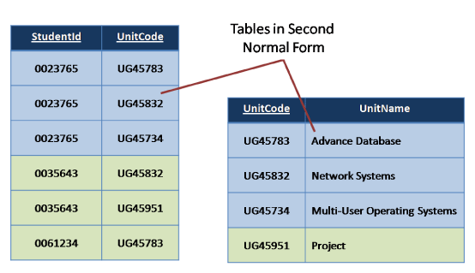
Second Normal Form 2NF

Slide 13
Rules of second normal form
A database is in second normal form (2NF) if it satisfies the following conditions:
It is in first normal form (1NF)
There should be a single primary key no composite key
No partial dependencies.
The primary key of the table should compose of exactly 1 column.

Slide 14
Problem 3 - All data must be atomic (non-divisible)

Slide 15
Second Normal Form (2NF)
The table has a composite primary key: student_id and class_id. The teacher column is determined only by the class_id, not by the entire composite primary of student_id and class_id.
This table will lead to data redundancy because of repeating teacher name
Break the table into two using primary and foreign key
student_id | class_id | teacher
1 | 1 | Smith
2 | 2 | Jackson
3 | 3 | James
4 | 2 | Jackson
student_id | class_id
1 | 1
2 | 2
3 | 3
4 | 2
class_id | teacher
1 | Smith
2 | Jackson
3 | James

Slide 16
Second Normal Form (2NF) Another example
The table is in 1NF, (All attribute are atomic) The course code and Instructor ID are set for the composite primary key.
All the non key attribute should depend only on the Composite primary Key. (Instructor phone number is partial dependency because it depends only on Instructor ID and not Course code)
Solution: Break the table into two using primary and foreign key
Course code | Course venue | Instructor ID | Instructor Name | Instructor’s phone number
CS101 | Lecture Hall 20 | UN1 | Prof. George | +1 6514821924
CS152 | Lecture Hall 21 | UN2 | Prof. Atkins | +1 6519272918
CS154 | CS Auditorium | UN1 | Prof. George | +1 6514821924
Course code | Course venue | Instructor ID
CS101 | Lecture Hall 20 | UN1
CS152 | Lecture Hall 21 | UN2
CS154 | CS Auditorium | UN1
Instructor ID | Instructor Name | Instructor’s phone number
UN1 | Prof. George | +1 6514821924
UN2 | Prof. Atkins | +1 6519272918

Slide 17
Second Normal Form (2NF) Another example
Composite key: {student, course}
The set {student, course} is the composite key, but the value of course fee is functionally dependent on course alone.
Course fee is a non-key attribute, which is functionally dependent on only part of the candidate key.
To transform this into 2NF, we split it into two relations:
Student courses (with the attributes student, course, and grade) and Courses (with the attributes course and course fee).
Hint There should be only one (1) primary key in the table
Student | Course | Grade | course fee
Alison Brown | Databases | A | $100
Jason Liu | Mathematics | B | $150
Mariah Hill | Databases | B+ | $10
Student | Course | Grade
Alison Brown | Databases | A
Jason Liu | Mathematics | B
Mariah Hill | Databases | B+
Course | course fee
Databases | $100
Mathematics | $150
Databases | $10

Slide 18
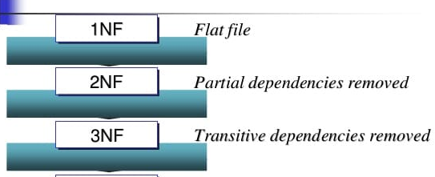
THIRD Normal Form 3NF

Slide 19

Rules of Third Normal Form (3NF)
A relation is in third normal form (3NF) if and only if:
It is in second normal form (2NF).
All, non key attributes must not depend on another non-prime attribute. (No transitive dependency)
No transitive dependency - All fields must only be determinable by the primary/composite key, not by other keys
3NF non-key attributes depend on “nothing but the key”.

Slide 20
Example - No partial dependency
Student ID | Course ID | Course Fee
1 | 1 | 500
1 | 2 | 1000
2 | 4 | 200
2 | 3 | 750
3 | 5 | 1000
3 | 3 | 750
This table is not in 2NF because the course Fee is only dependent on the primary key to determine the course fee, you can do it with just one column (course ID)

Slide 21
Example - No partial dependency
Student ID | Course ID
1 | 1
1 | 2
2 | 1
2 | 3
3 | 5
3 | 3
Course ID | Course Fee
1 | 500
2 | 1000
3 | 750
4 | 200
5 | 1000
6 | 300

Slide 22
Third Normal Form (3NF)
Primary key: order_id
Non-prime attributes: date, customer, customer email
Functional dependencies:
date depends on order_id (order_id → date)
customer depends on order_id (order_id → customer),
customer email depends on customer (customer → customer email).
The only candidate key in this relation is order_id.
The value of customer email is functionally dependent on the customer attribute, which is a non-key attribute.
Therefore, the relation violates 3NF.
order_id | date | customer | customer email
1/2020 | 2020-01-15 | Jason White | white@example.com
2/2020 | 2020-01-16 | Mary Smith | msmith@mailinator.com
3/3030 | 2020-01-17 | Jacob Albertson | jasobal@example.com
4/2020 | 2020-01-18 | Bob Dickinson | bob@fakemail.com

Slide 23
Activity
Complete the question of the given worksheet
You may discuss your answers with your classmates

